Slide 1
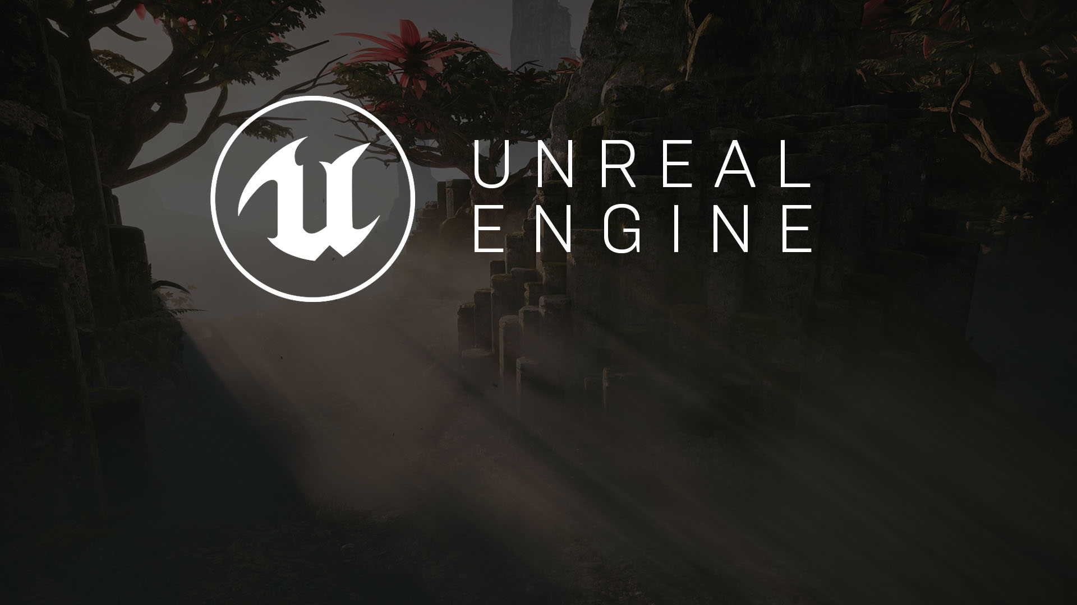
STAMINA SYSTEM
Homework’s Solution

Slide 2
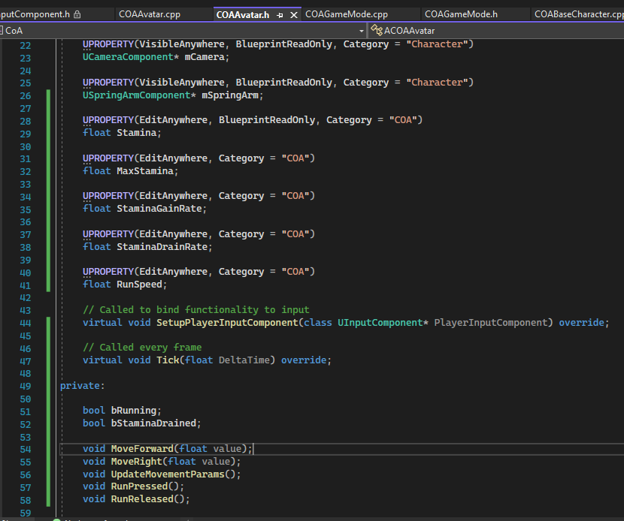

Stamina System
Implementation Steps #6
Add these properties: Stamina, MaxStamina, StaminaGainRate, StaminaDrainRate,RunSpeed to ACOAAvatar.h
Implement UpdateMoveParams, RunPressed and RunReleased methods.

Slide 3
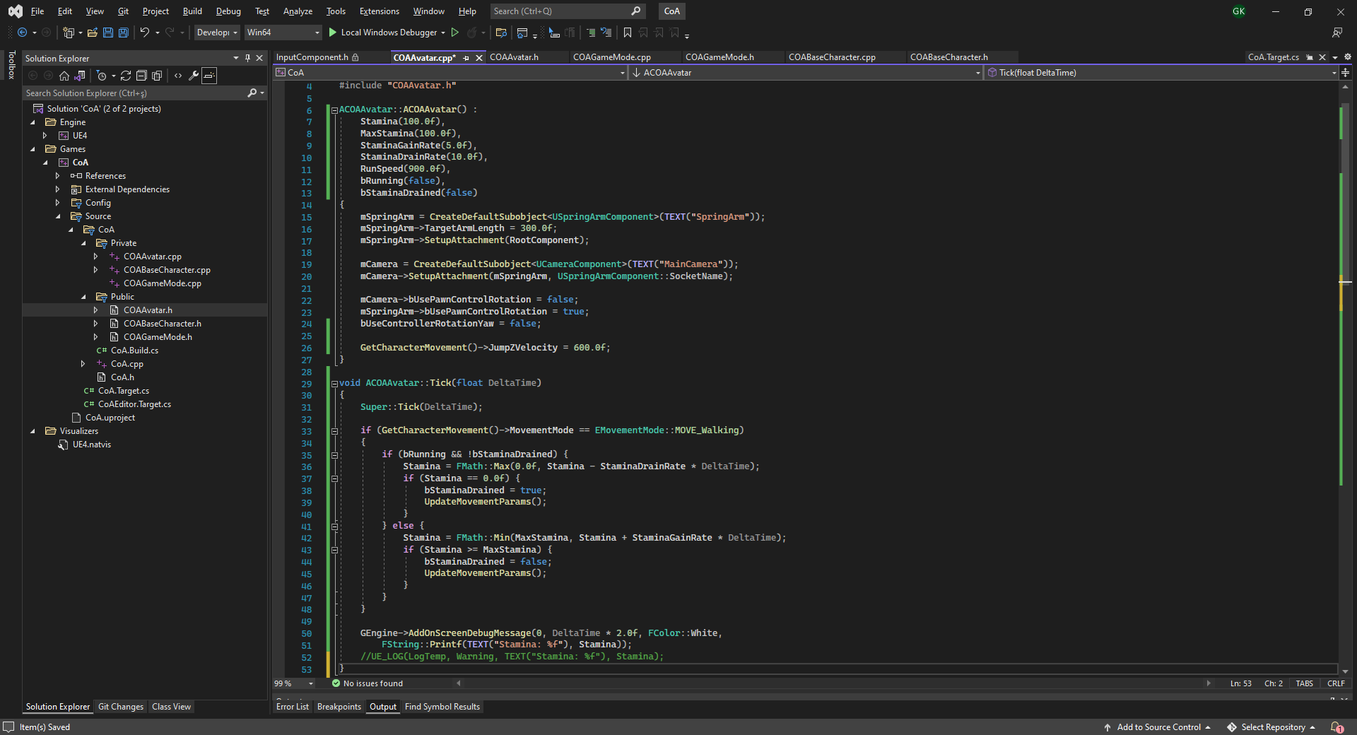
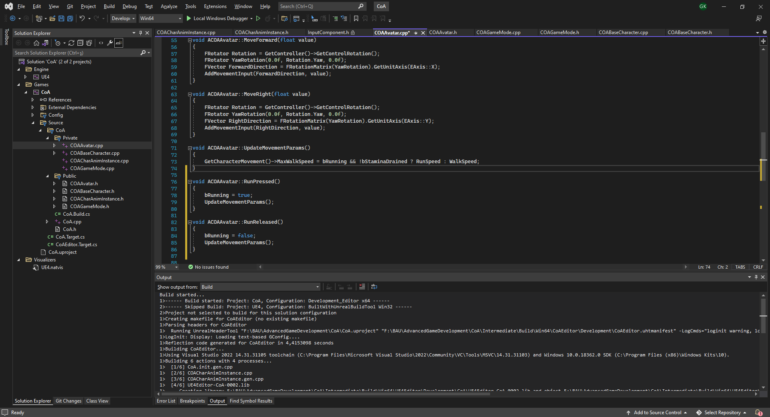
Stamina System
Implementation Steps #6 (Continued…)
UpdateMovementParams() can be used to refresh movement state of the character in general here.
When Stamina is drained by running, bStaminaDrained flag becomes true, preventing running until the Stamina reached to MaxStamina value.
Stamina value can be printed on screen using:
GEngine->AddOnScreenDebugMessage() method
or printed onto the dev log with
UE_LOG() macro.

Slide 4

Robo Recall Example:
Character Damage System
Robo Recall has a C++ base class for all characters called “AOdinCharacter”.
Within “AOdinCharacter” is the “TakeDamage” function, which handles how a character responds to being damaged. Most of the tasks involved in “TakeDamage” are common to all Characters.
“AOdinCharacter” also adds a Native Event called “BlueprintModifyPointDamage”, which is called inside “TakeDamage”. When overridden in Blueprint subclasses, this function allows each subclass to take the damage being dealt and make a change to it.
The designers created a large variety of enemy characters in Blueprint for Robo Recall, some of which used “BlueprintModifyPointDamage” to different ends, including the following:
Reducing the damage to 0 if the character was in a state of invincibility
Increasing the amount of damage if a particular weak point was hit
Decreasing the amount of damage if the part of the enemy hit was armored
Diverting the damage to shields if the enemy has shields
Multiplying the damage for drone enemies when in a swarm
Notes:
This example will explain how Robo Recall structured its Character Damage to capture the complexity in the base C++ classes while allowing designers to customize the design of each individual character in Blueprint.
TakeDamage is a function built into the base Actor class. The base character class in C++ (AOdinCharacter) overrides this function to manage the common tasks of handling being damaged, including subtracting that damage from the character’s health, killing the character if its health reaches 0, and notifying various other systems that this character has taken damage.
AOdinCharacter also adds a Native Event called BlueprintModifyPointDamage, which is called inside TakeDamage. When overridden in Blueprint subclasses, this function allows each subclass to take the damage being dealt and make a change to it.
The designers created a large variety of enemy characters in Blueprint for Robo Recall, some of which used BlueprintModifyPointDamage to different ends, including
Reducing the damage to 0 if the character was in a state of invincibility
Increasing the amount of damage if a particular weak point was hit
Decreasing the amount of damage if the part of the enemy hit was armored
Diverting the damage to shields if the enemy has shields
Multiplying the damage for drone enemies when in a swarm

Slide 5
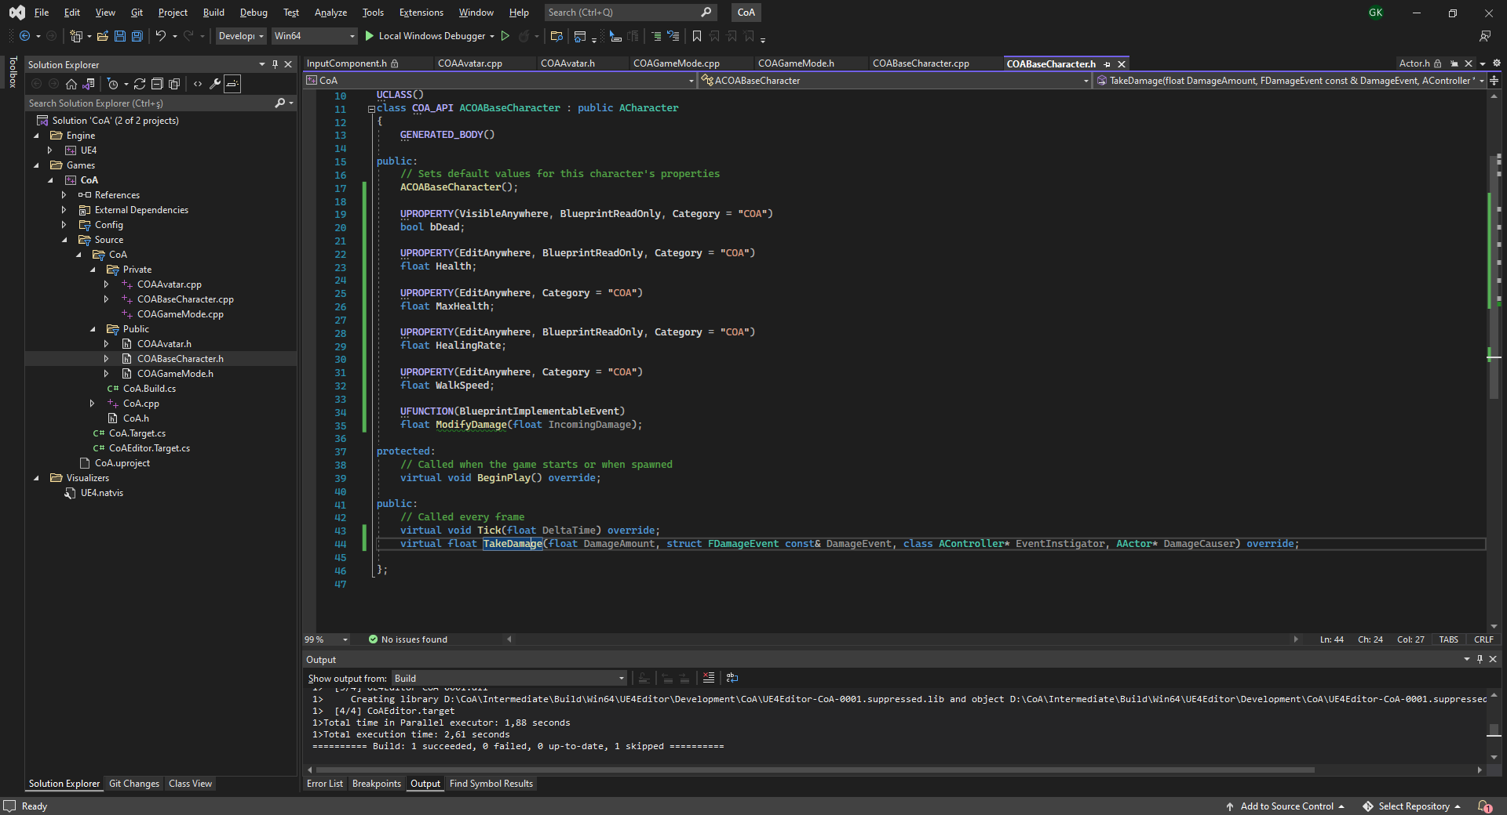
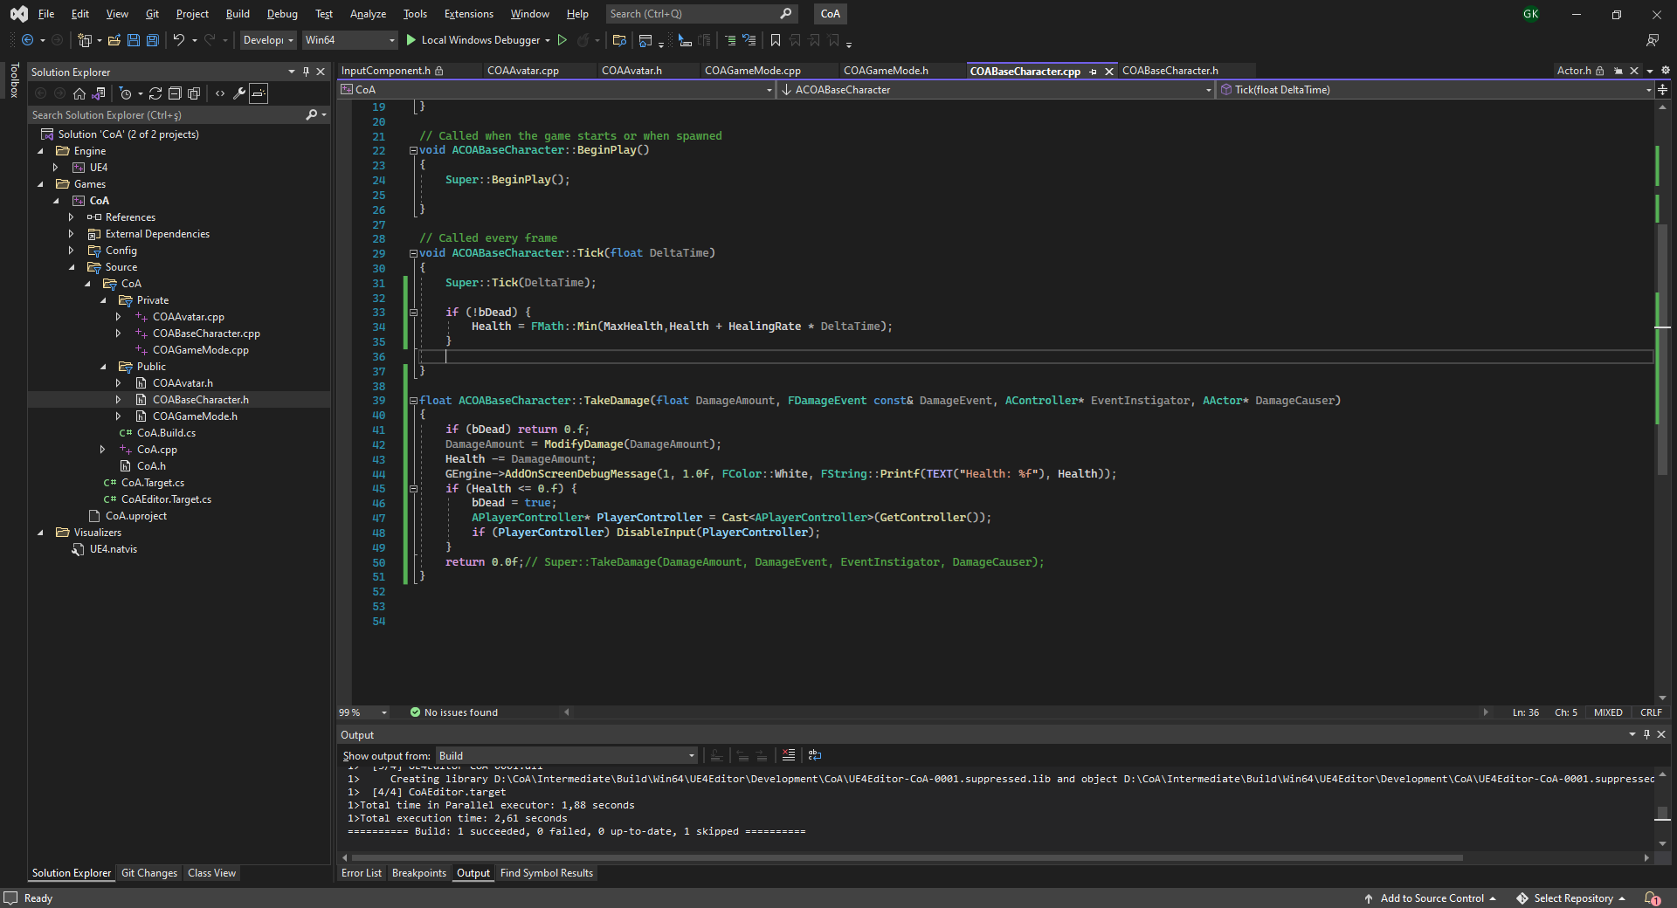
Damage System
Implementation Steps #7
Implement TakeDamage() actor interface at ACOABaseCharacter.h
Add Blueprint implementable event ModifyDamage(). This one allows blueprint modify the final damage value.
If the character’s health drops below zero, takedamage will also disable input here.
Make a blueprint actor to applyDamage() on any character it overlaps. Name it to BP_DamageVolume.

Slide 6
ANIMATION CODING
Basic Combat Mechanics

Slide 7
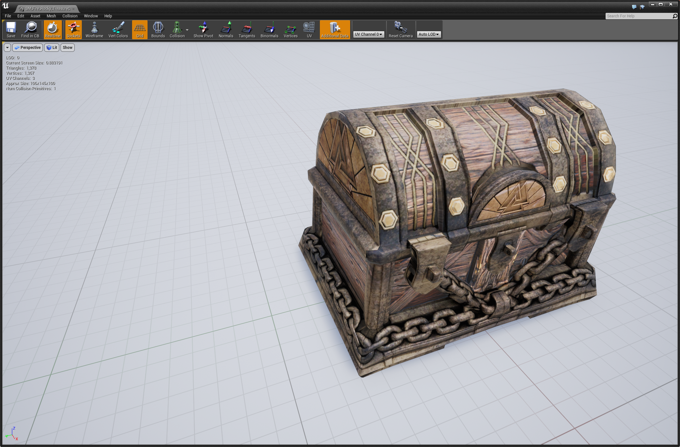
Static Meshes
Static Meshes are the basic unit used to create world geometry for levels created in the Unreal Engine. These are 3D models created in external modeling applications (such as 3ds Max, Maya, and so on) that are imported into the Unreal Editor through the Content Browser, saved in packages, and then used in various ways to create renderable elements.
The vast majority of any map in a game made with Unreal will consist of Static Meshes, generally in the form of Static Mesh Actors. Other uses of Static Meshes are for creating moveable Actors such as doors or lifts, rigid body physics objects, foliage and terrain decorations, procedurally created buildings, game objectives, and many more visual elements.

Slide 8

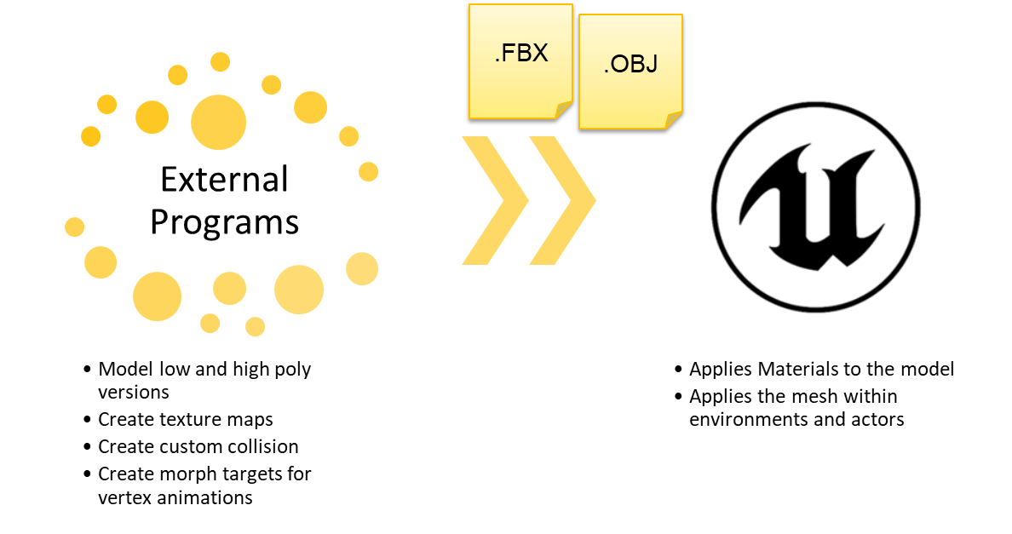
A high-level overview of the
Static Mesh pipeline

Slide 9
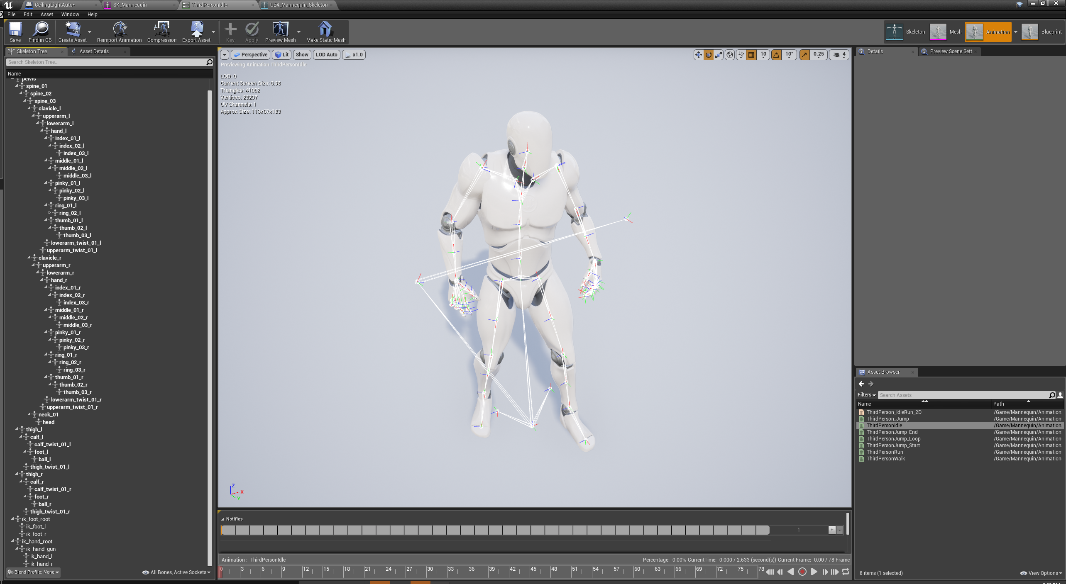
Skeletal Meshes
Skeletal Meshes are made up of two parts: a set of polygons composed to make up the surface of the Skeletal Mesh, and a hierarchical set of interconnected bones that can be used to animate the vertices of the polygons.
Skeletal Meshes are often used in Unreal Engine 4 to represent characters or other animating objects. The 3D models, rigging, and animations are created in an external modeling and animation application (such as 3ds Max, Maya, Softimage, and so forth) and are then imported into UE4 and saved into packages by using Unreal Editor’s Content Browser.

Slide 10

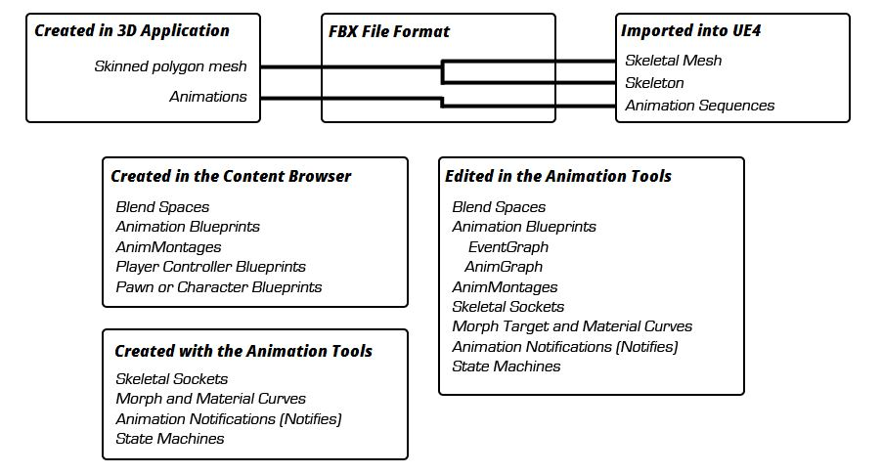
Skeletal Animations
The Unreal Engine 4 animation system is composed of several Animation Tools and Editors that mix skeletal-based deformation of meshes with morph-based vertex deformation to allow for complex animation.
You can import animations into Unreal Engine from any 3D modeling application with a save/export feature supporting the FBX file format.

Slide 11
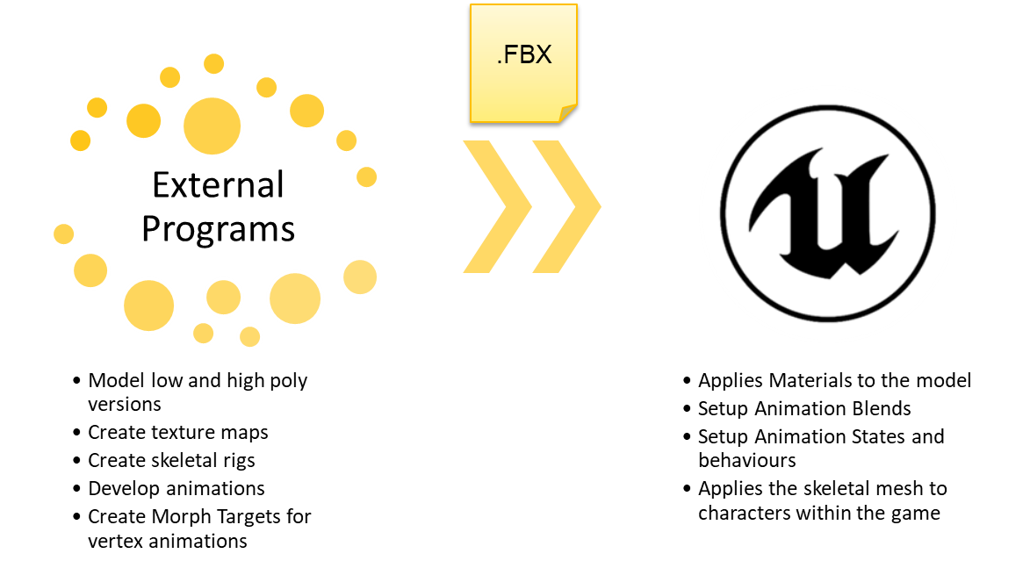
A high-level overview of the
Skeletal Mesh pipeline

Slide 12
Animation Blueprints
Are coupled with a single skeleton but can be retargeted to similar skeletons
Are imported from FBX files
Animation Sequences
Are coupled with a single skeleton
Character Models
Can be shared across multiple characters
Skeleton
Animation Montages
Enable animation blending through State Machines
Feature Blueprint Scripting for animation calculations and inverse kinematics
Play in Animation Blueprint Slots and blend in/out
Can be broken up into sections to contain large chains in a single montage
Animation Implementation
The animation system in Unreal Engine 4 is composed of several Animation Tools and Editors that mix skeletal-based deformation of meshes with morph-based vertex deformation to allow for complex animation. This system can be used to make basic player movement appear much more realistic by playing and blending between canned Animation Sequences, create customized special moves such as scaling ledges and walls using Anim Montages, apply damage effects or facial expressions through Morph Targets, directly control the transformations of bones using Skeletal Controls, or create logic-based State Machines that determine which animation a character should use in a given situation.

Slide 13
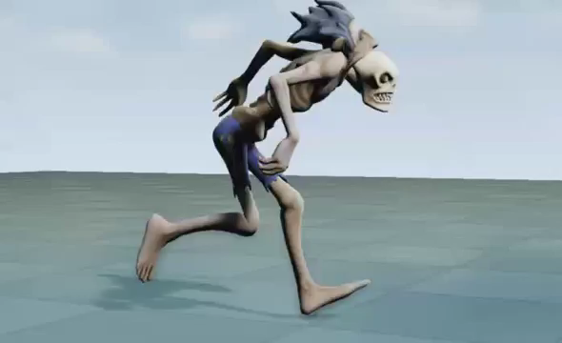
Animation Sequences
An Animation Sequence is a single animation asset that can be played on a Skeletal Mesh. These contain keyframes that specify the position, rotation, and scale of a bone at a specific point in time. By playing these keyframes back in sequence, with blending between them, the bones of a Skeletal Mesh can be smoothly animated.
Each Animation Sequence asset targets a specific Skeleton and can only be played on that Skeleton. This means that in order to share animations between multiple Skeletal Meshes, each of the meshes must use the same Skeleton asset.

Slide 14
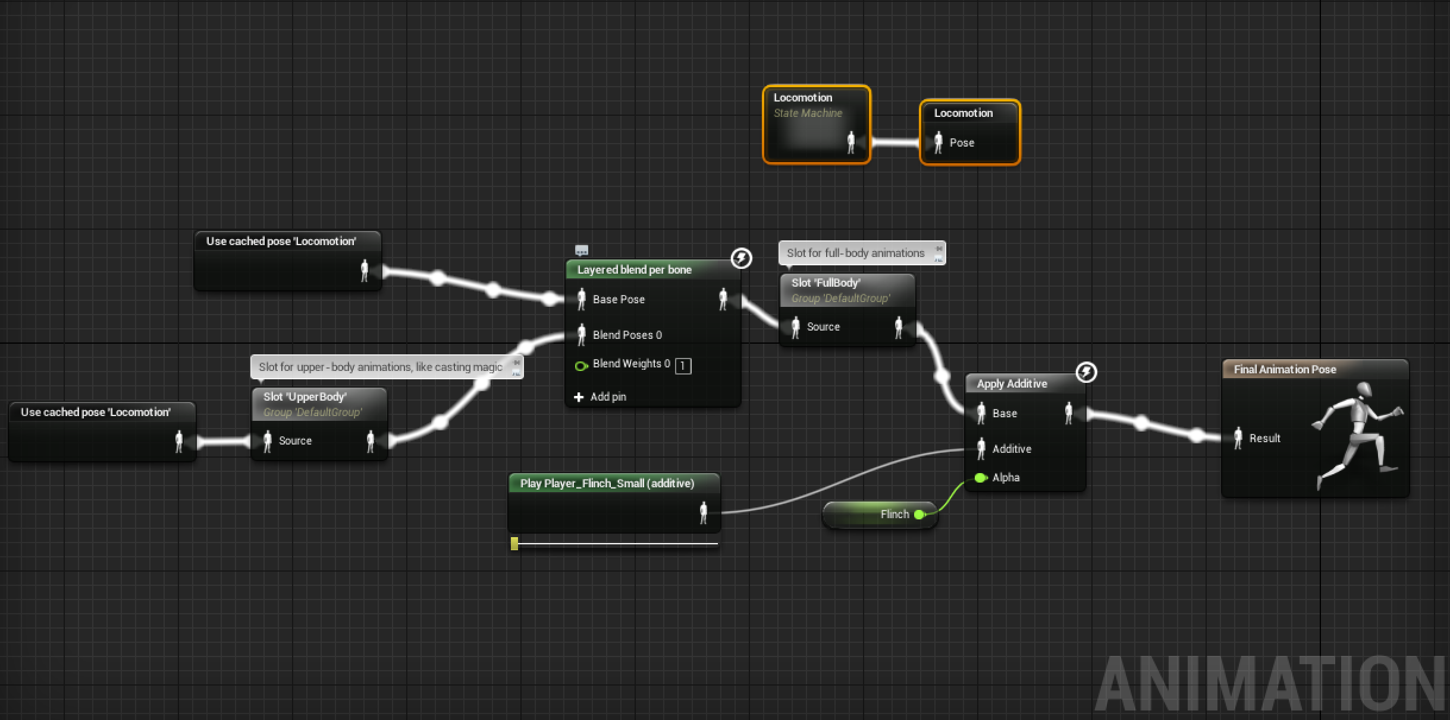
Animation Blueprint:
Anim Graph
The AnimGraph is used to evaluate a final pose for the Skeletal Mesh for the current frame. By default, each Animation Blueprint has an AnimGraph that can have Animation Nodes placed within it to sample Animation Sequences, perform animation blends, or control bone transforms using Skeletal Controls. The resulting pose is then applied to the Skeletal Mesh for each frame.
AnimGraph of the Couch Knight

Slide 15
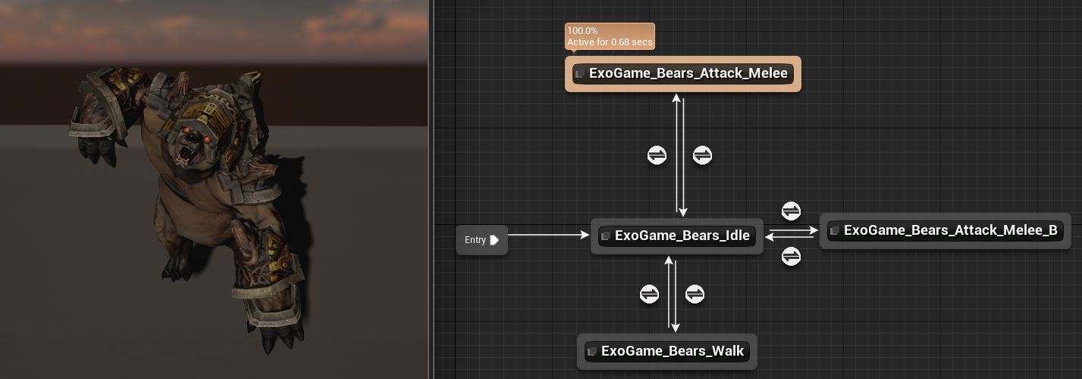
Animation Blueprint: State Machines
State Machines provide a graphical way to break the animation of a Skeletal Mesh into a series of States. These states are then governed by Transition Rules that control how to blend from one state to another. As a tool, they greatly simplify the design process for Skeletal Mesh animation in that you can create a graph that easily controls how your characters can flow between types of animation without having to create a complex Blueprint network.
An example of a simple
Animation State Machine

Slide 16
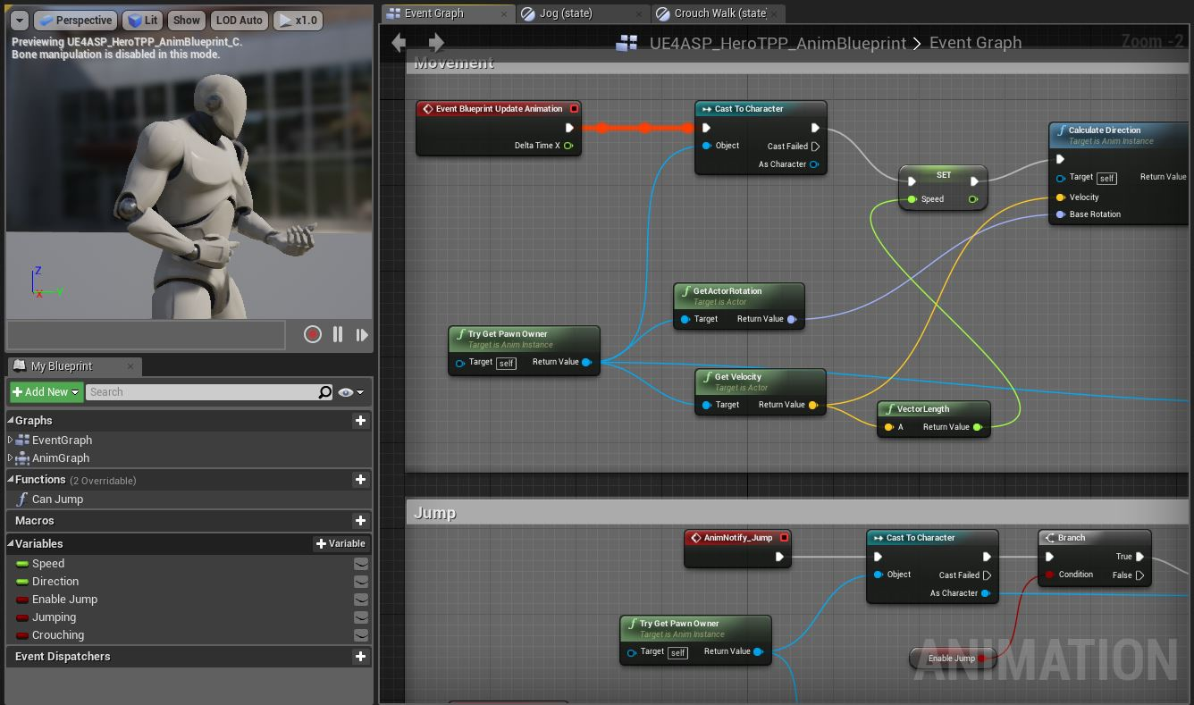
Animation Blueprint: Event Graph
The EventGraph performs updates to values that are then used in the AnimGraph to drive State Machines, Blend Spaces, or other nodes, allowing blending between multiple Animation Sequences or poses that can fire off notifications to other systems, enabling dynamic animation-driven effects.
An example of the Event Graph in an Animation Blueprint

Slide 17
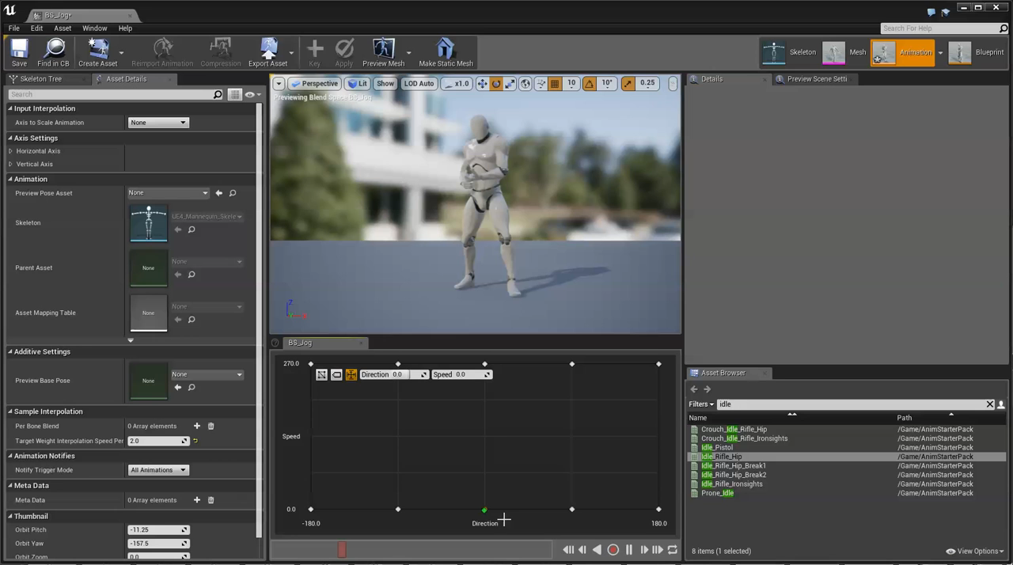
Animation Blueprint: Blend Spaces
Blend Spaces are special assets that can be sampled in AnimGraphs that allow for blending of animations based on the values of two inputs. Simple blending between two animations based on a single input can be performed using one of the standard Blend nodes available in Animation Blueprints. Blend Spaces provide a means of doing more complex blending between multiple animations based on multiple values (currently limited to two).
A simple Blend Space

Slide 18
ANIMATION SETUP
DOWNLOAD CONTENT WEEK #4:
https://bit.ly/3SuXLTK

Slide 19
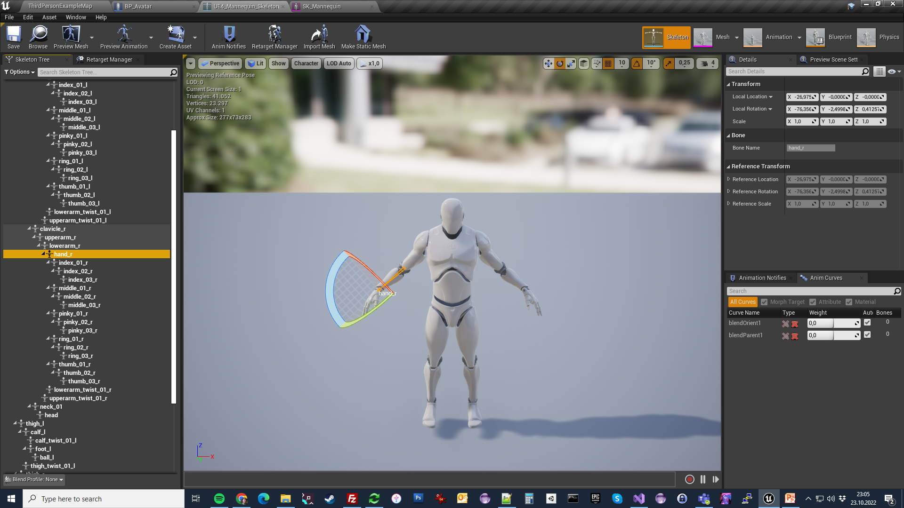
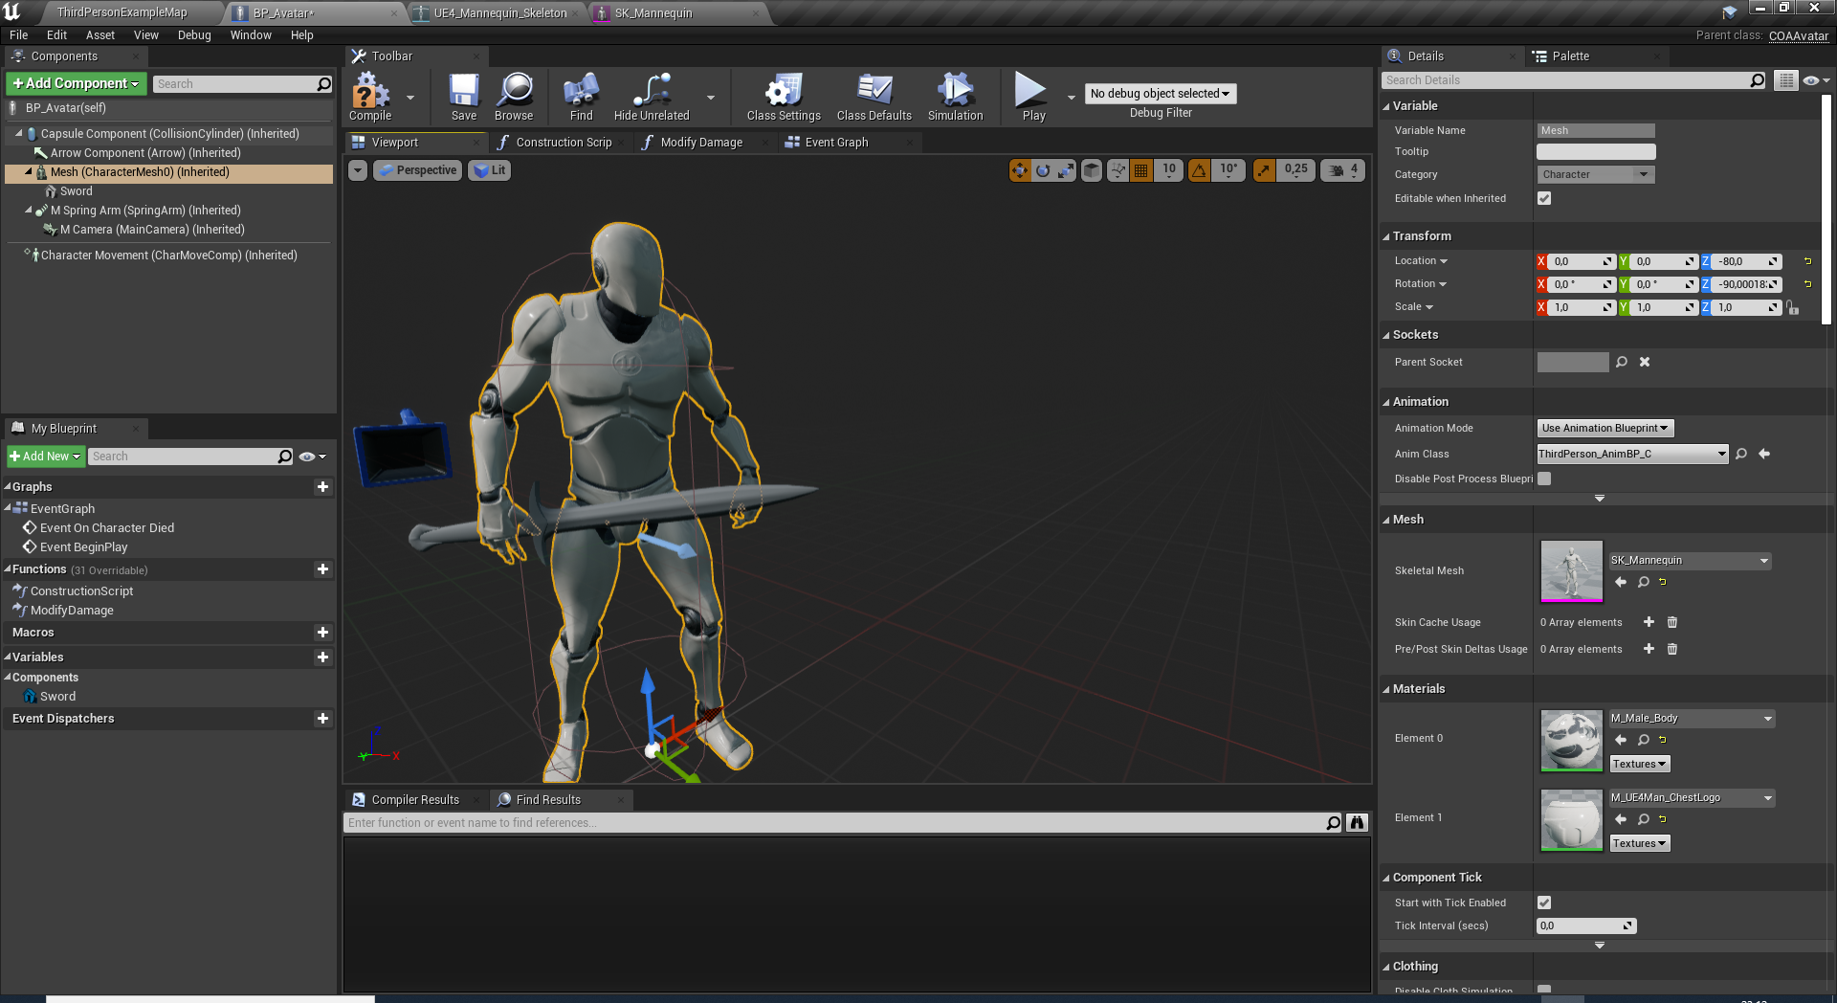
CREATING SOCKETS
Add a new socket to «hand_r» called Socket_Sword
Add «Sword» static mesh as preview asset to the socket and position it correctly on the right hand bone.
Go back to BP_Avatar and add a child static mesh with sword asset to the skeletal Mesh.

Slide 20
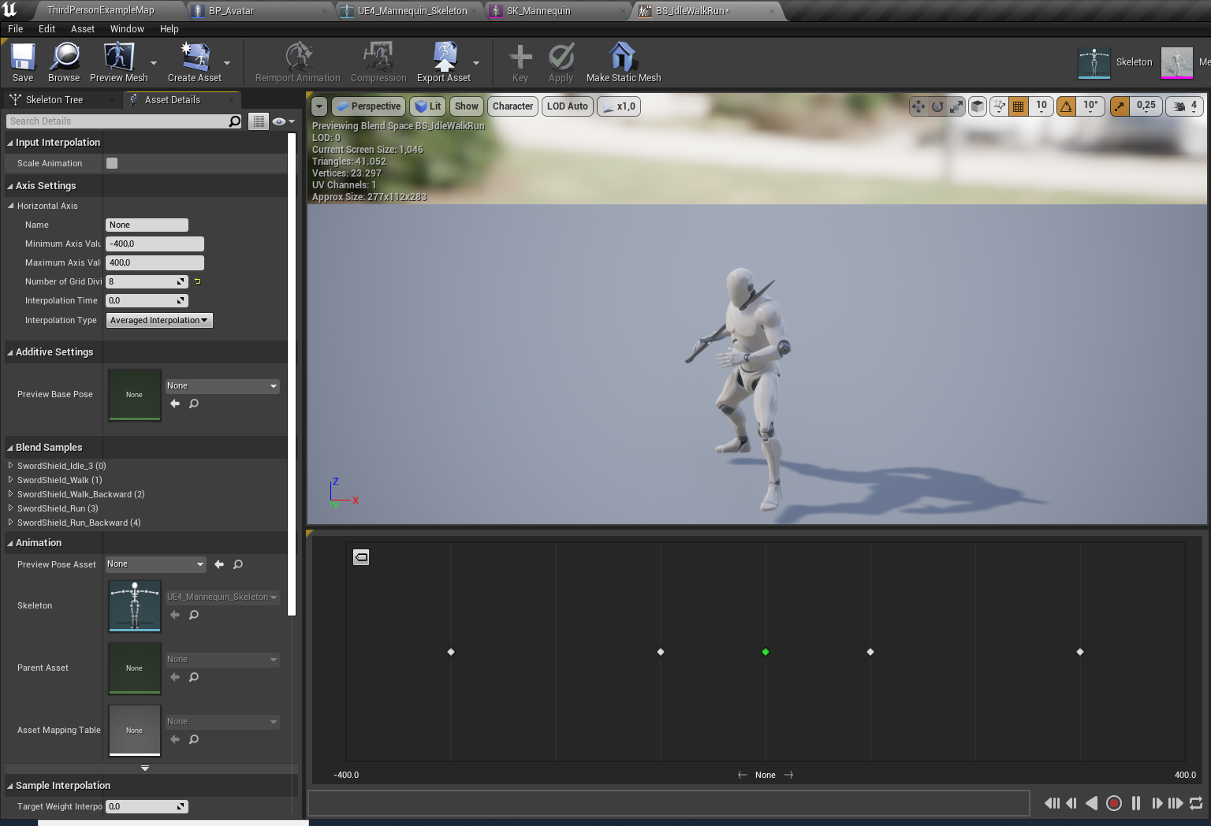
BLENDSPACE
Goto Mannequin/Animations folder and create a BlendSpace1D asset with the name: «BS_IdleWalkRun»
We will use running forward and backwards with + and – values.
Axis Settings between -400 and 400.
400 means fully running forward, 100 means fully walking. – values mean backwards.
Axis Name will be «Speed».
8 grid division will be required.
Place backward and forward walking and running animations on the grid.
Hold «Left Shift» to preview how the avatar moves at specific speeds.

Slide 21
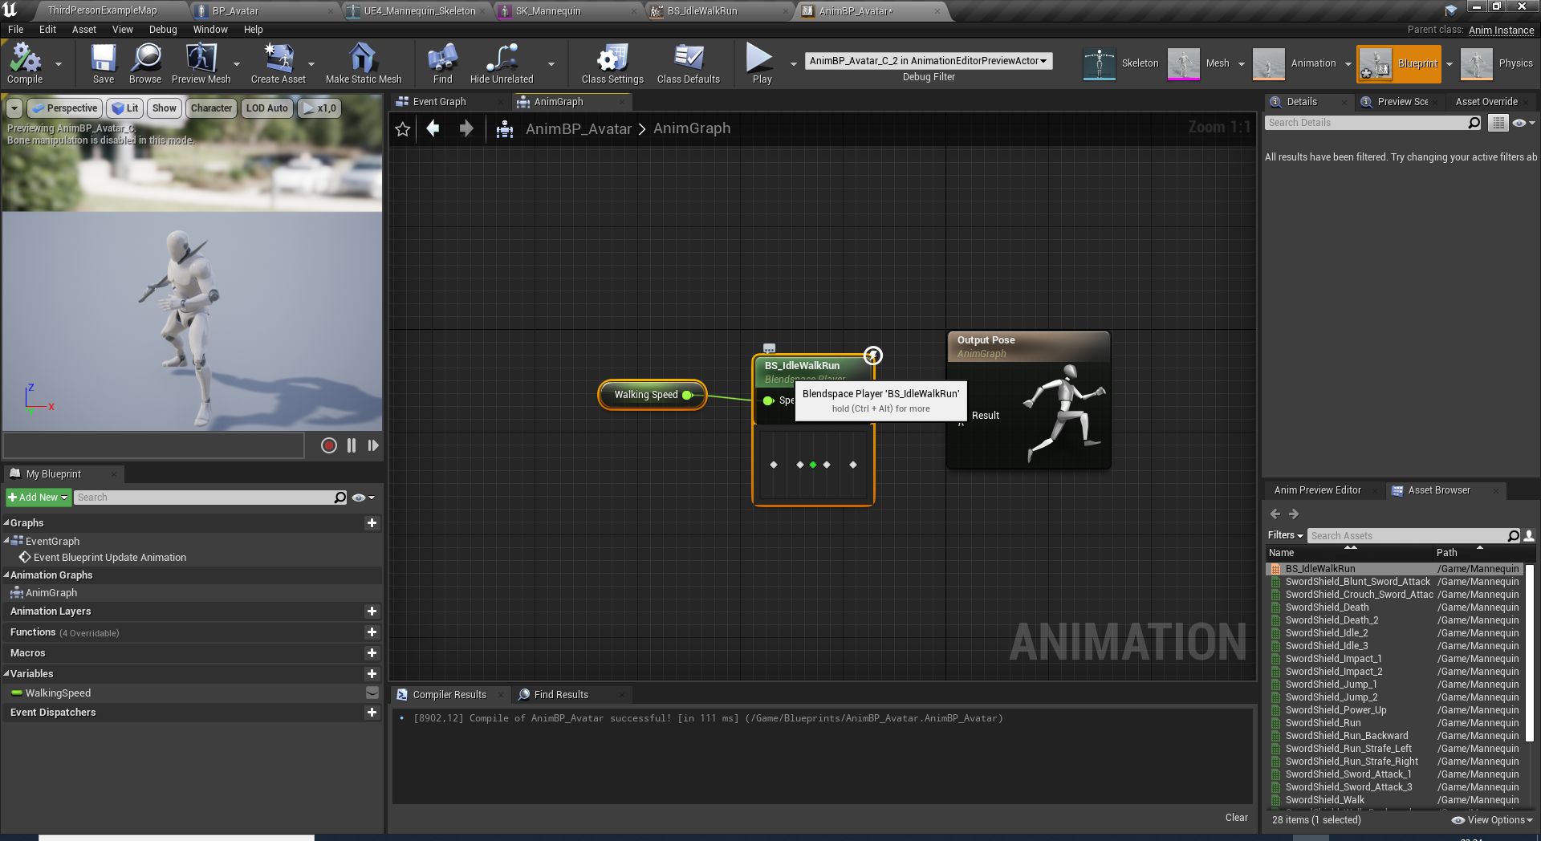
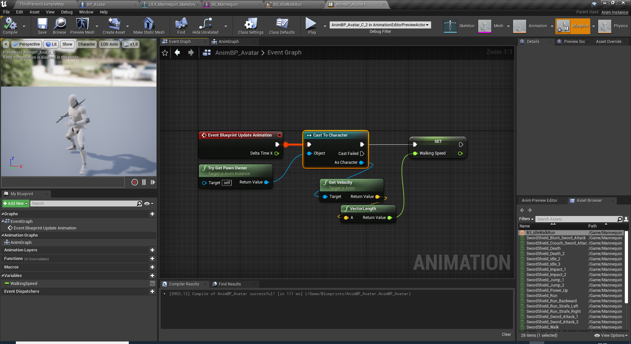
ANIMATION BLUEPRINT
Goto Blueprints folder and create a new Animation Blueprint based on the mannequin skeleton.
Name it to «AnimBP_Avatar»
Open the animbp and goto AnimGraph.
Drag drop the BS_IdleWalkRun and plug it to OutputPose.
Promote Speed pin into a variable named «WalkingSpeed»
Switch to EventGraph and compute the WalkingSpeed at every tick through avatar’s velocity vector’s length.
Now we have implemented a simple walking and running character.

Slide 22
ANIMINSTANCE CODING
Animation State Enumerations

Slide 23
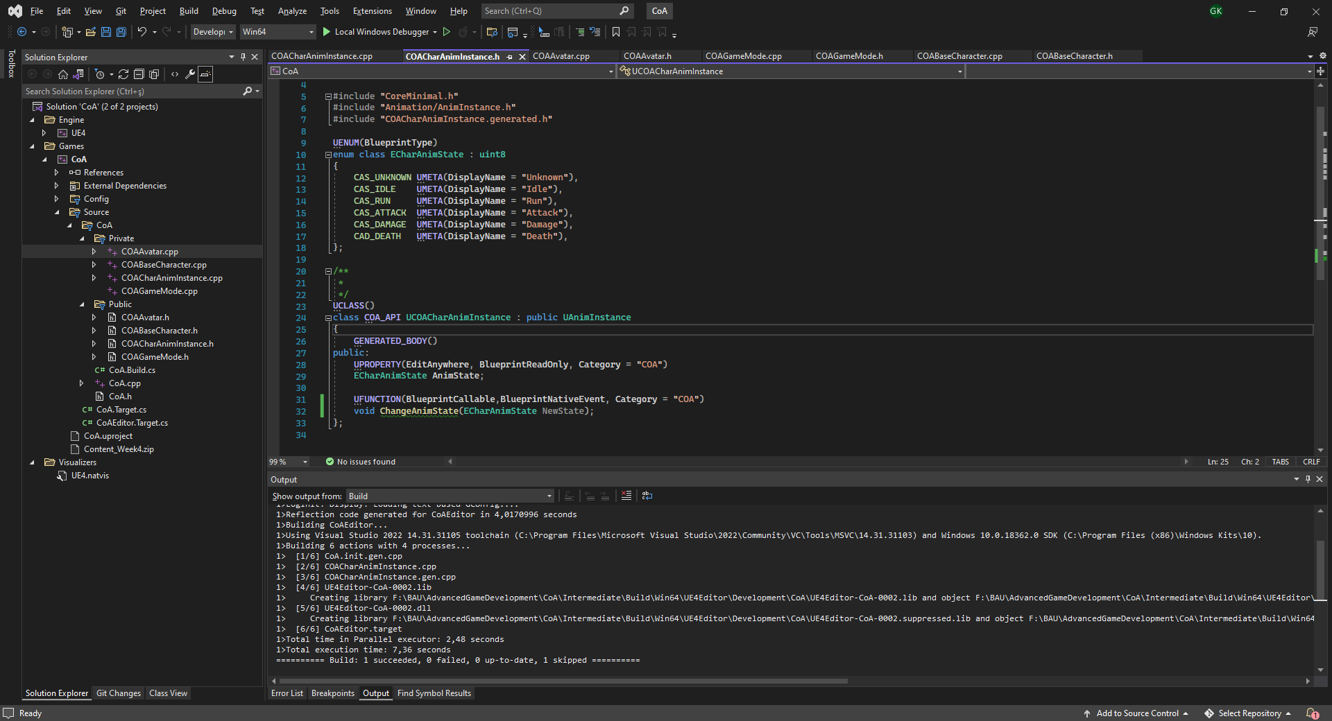
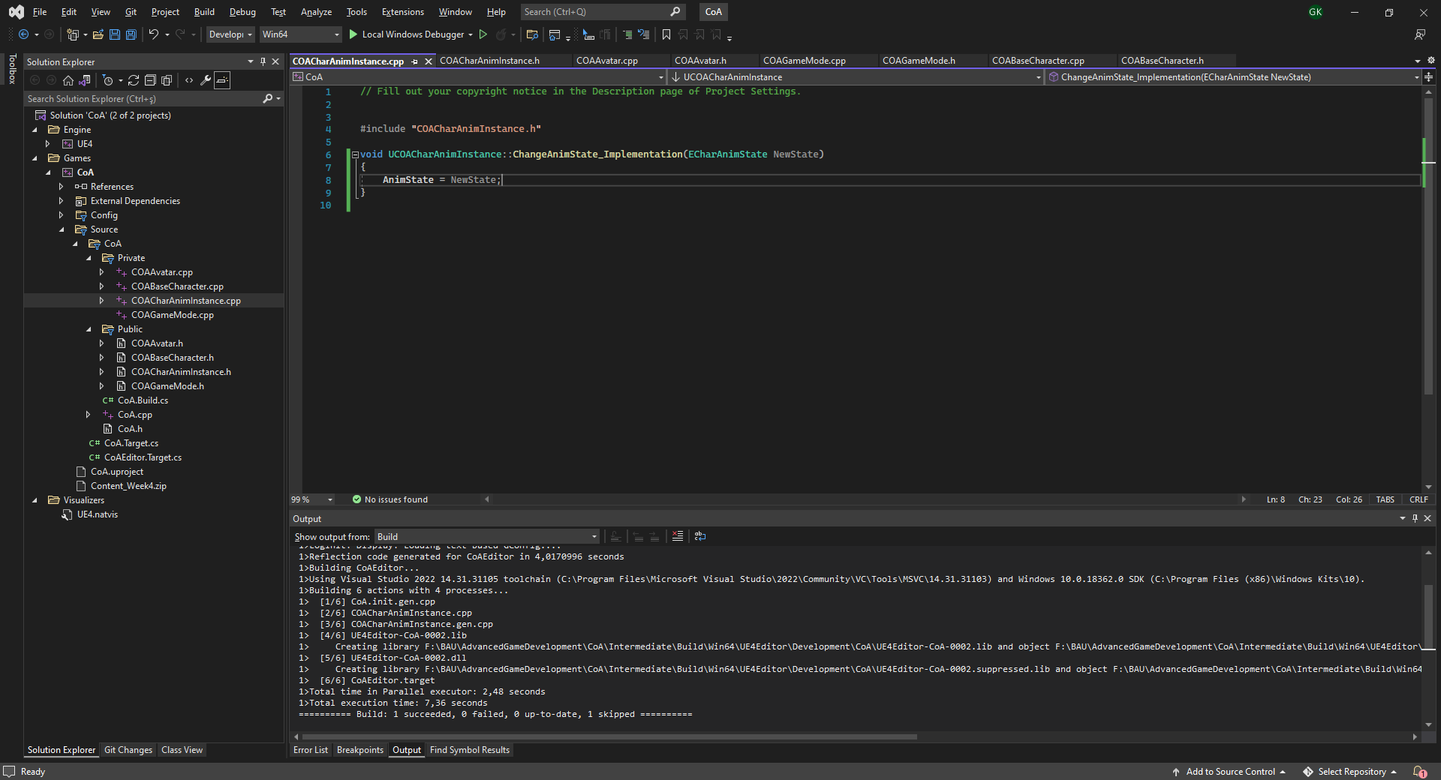
ANIMINSTANCE CLASS
Add a new C++ class to the project.
Pick parent class as «AnimInstance»
Name it to «COACharAnimInstance»
Add the basic animation states as an enumeration from c++ code as follows:
Unknown
Idle
Run
Attack
Damage
Death
Implement AnimState blueprint readonly property.
Implement ChangeAnimState BlueprintNativeEvent function to change the value of the property.
Add ChangeAnimState_Implementation body to the cpp file as well. This one change the AnimState variable’s value.
Goto Class Settings of AnimBP_Avatar and reparent the blueprint to «COACharAnimInstance»

Slide 24
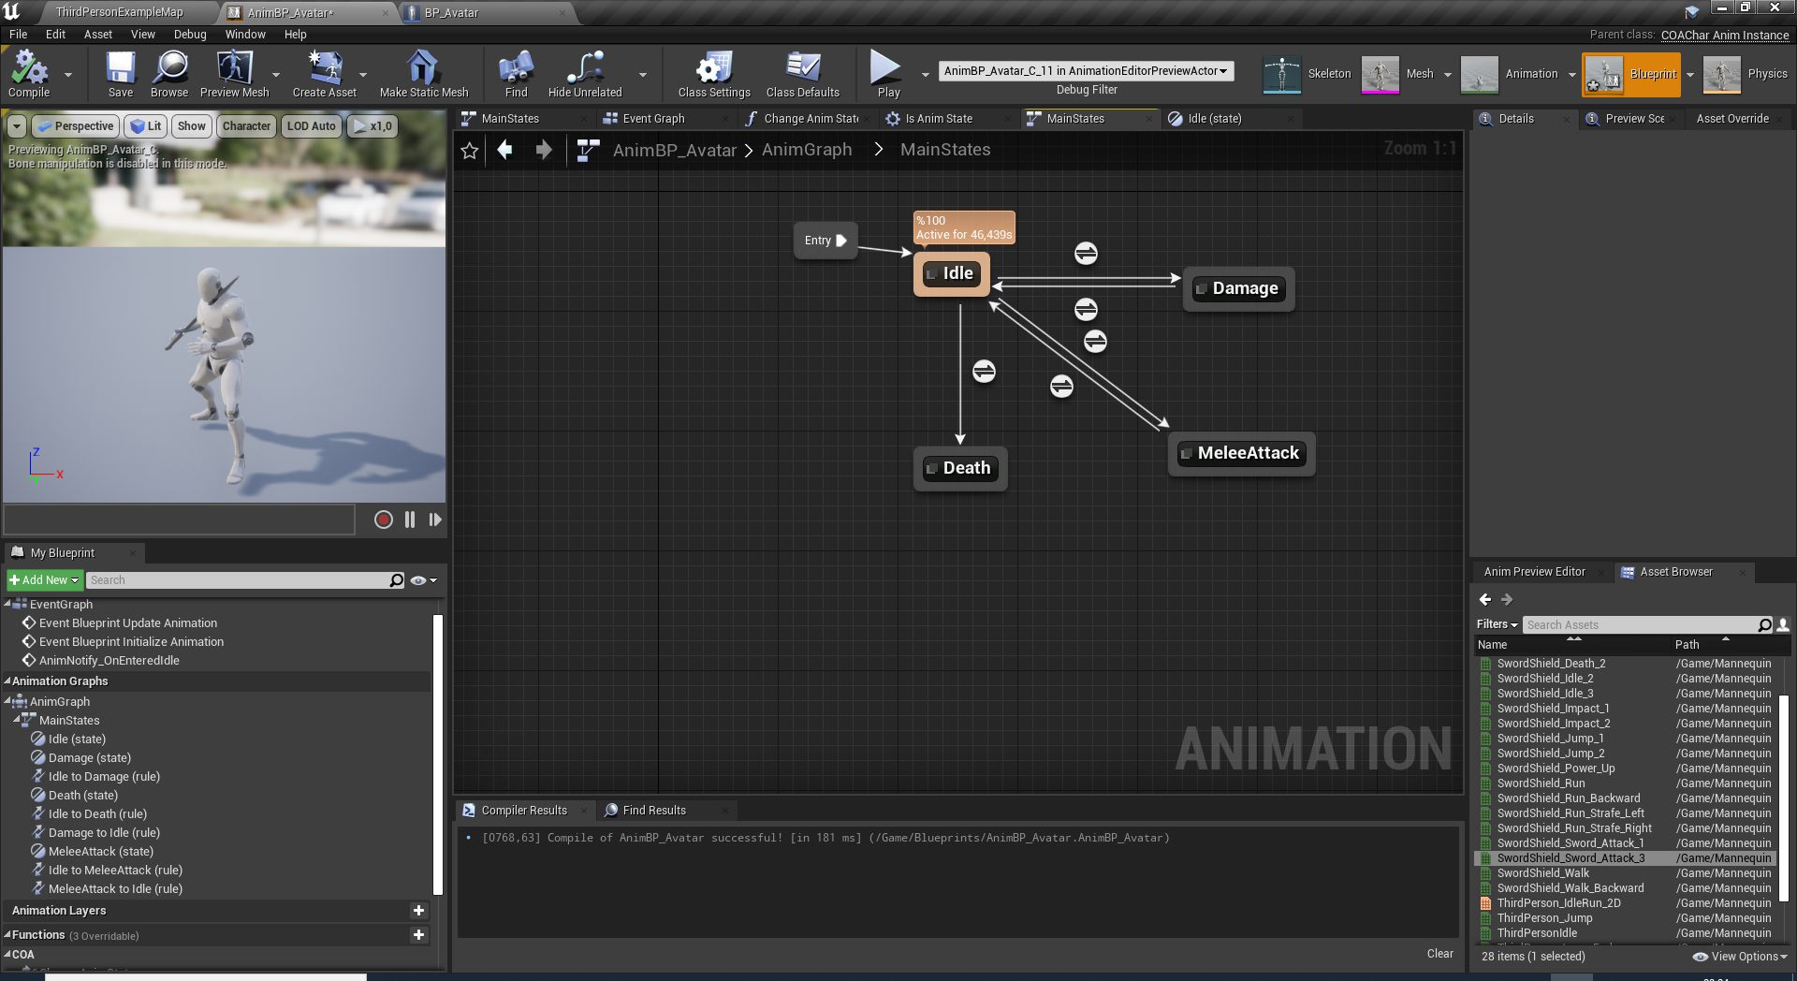
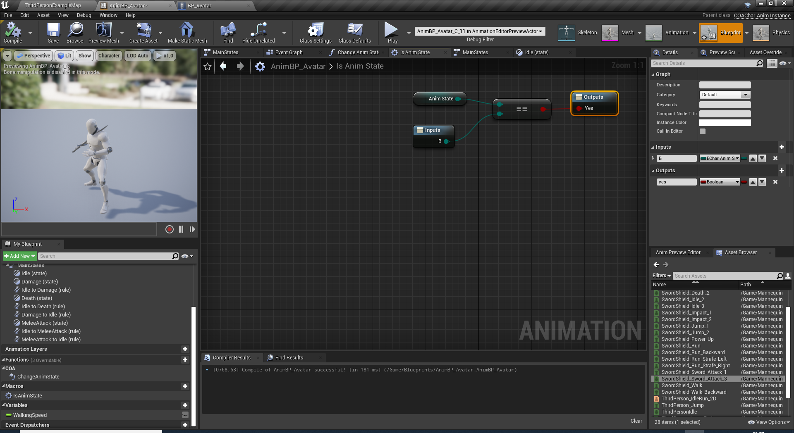
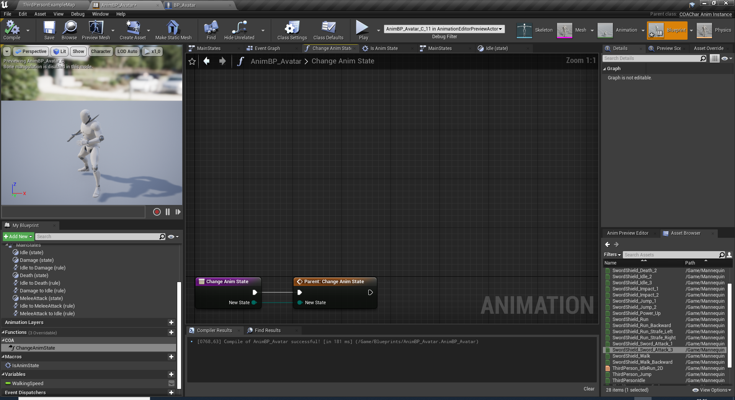
ANIMINSTANCE CLASS
Goto AnimGraph and create a state machine names «MainStates»
Create base states under MainStates machine: Idle,Attack,Damage,Death.
Override ChangeAnimState event. We will add state specific implementation here. Like picking a random different animation for each state..etc
Add a new macro names IsAnimState to check animstate to transtition rules for each state.

Slide 25
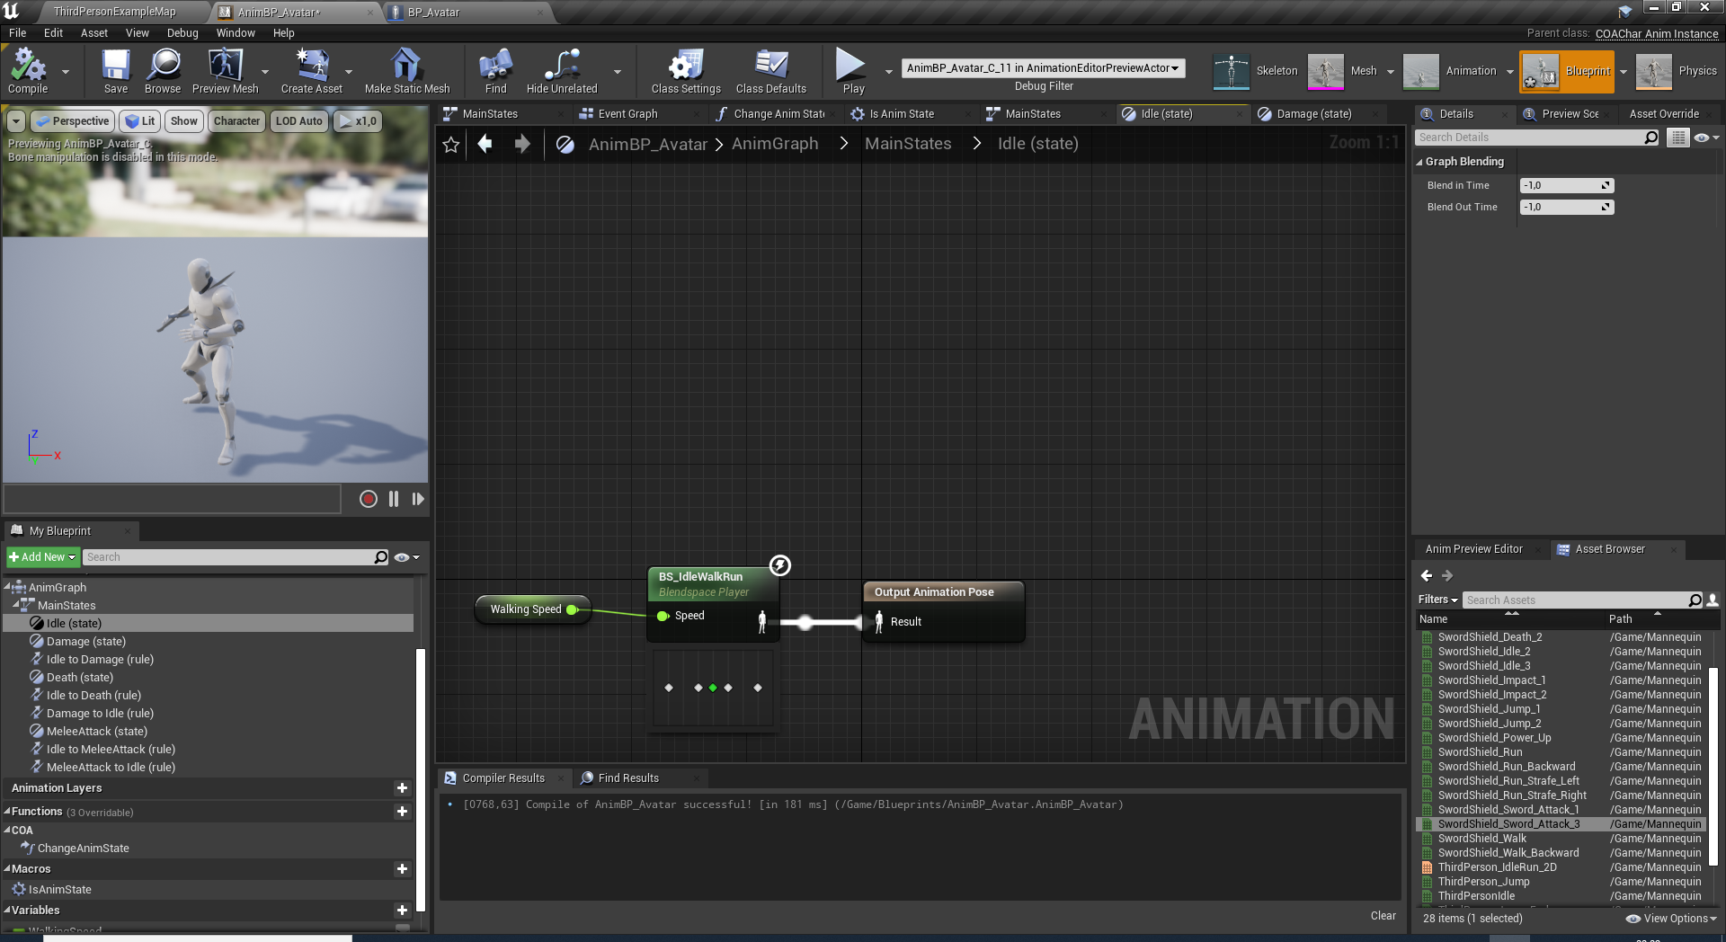
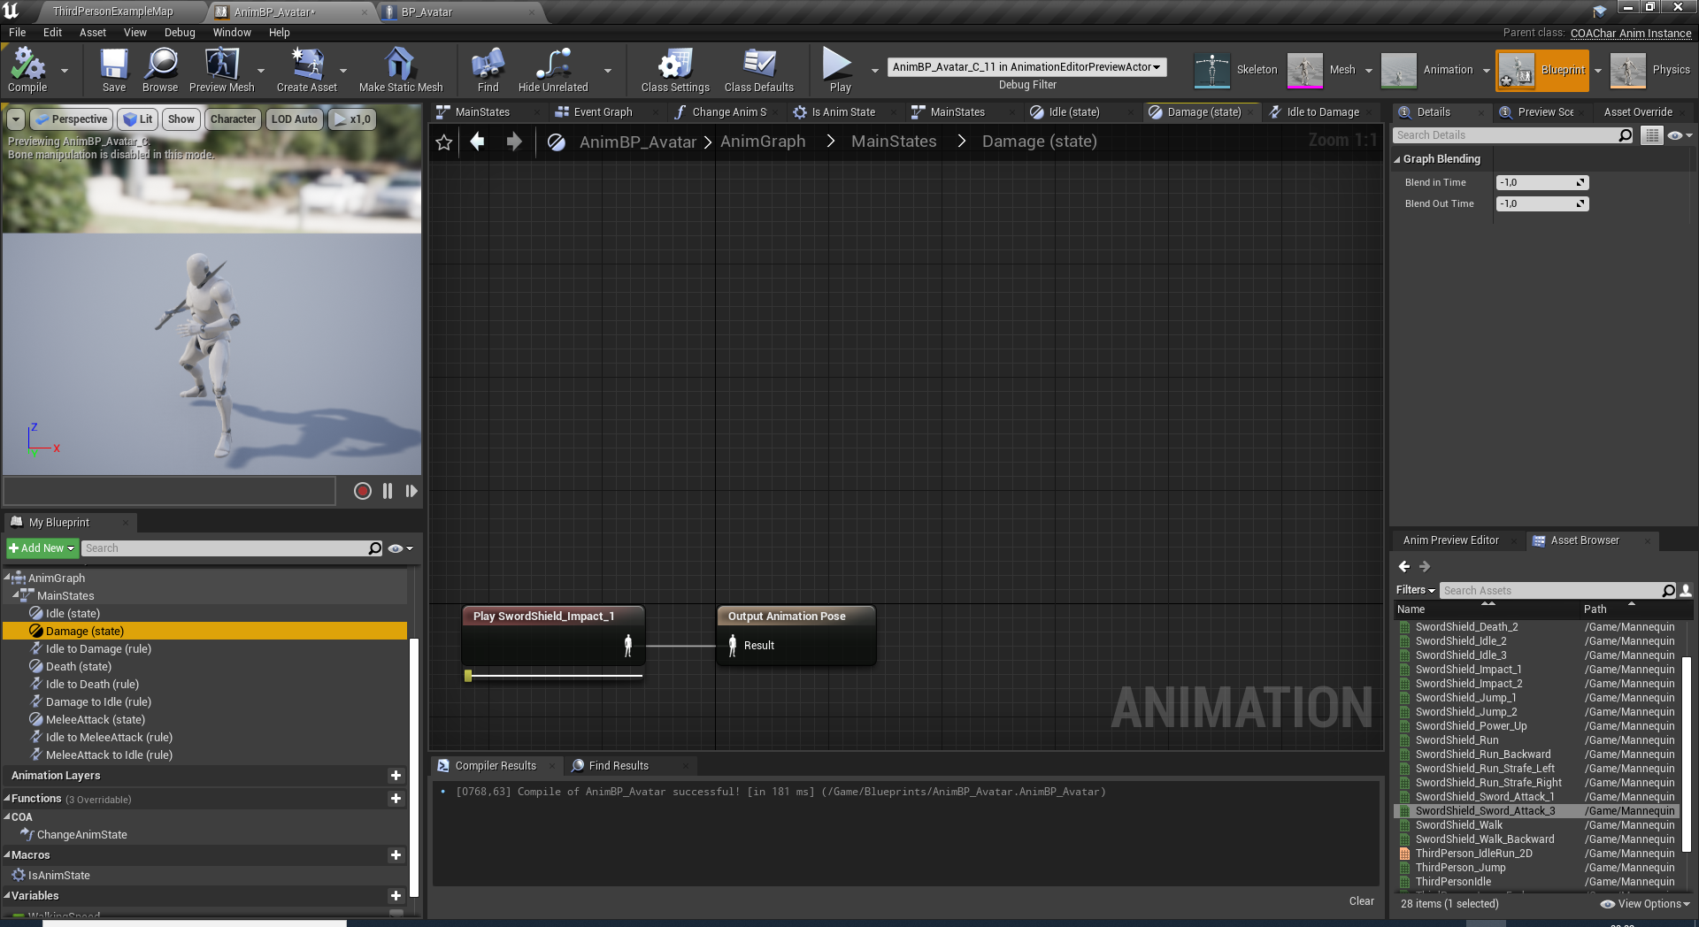
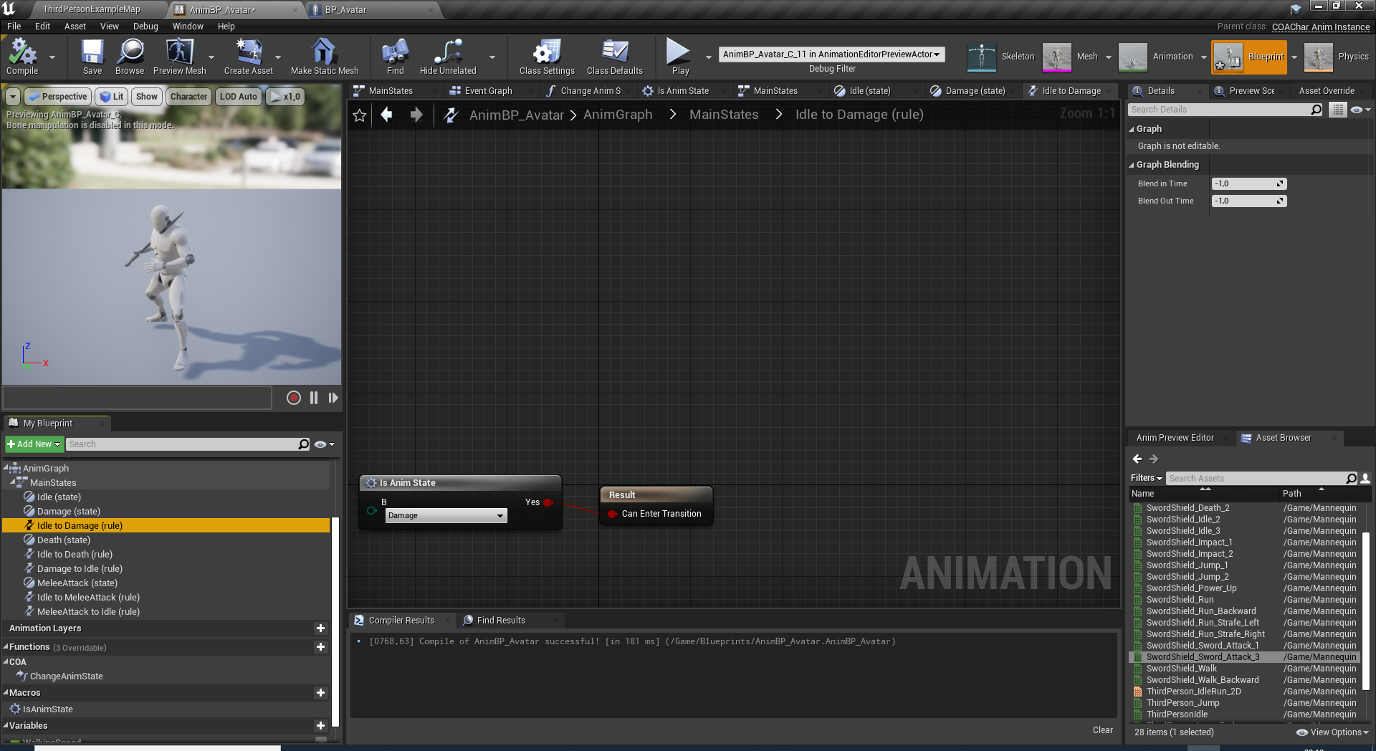
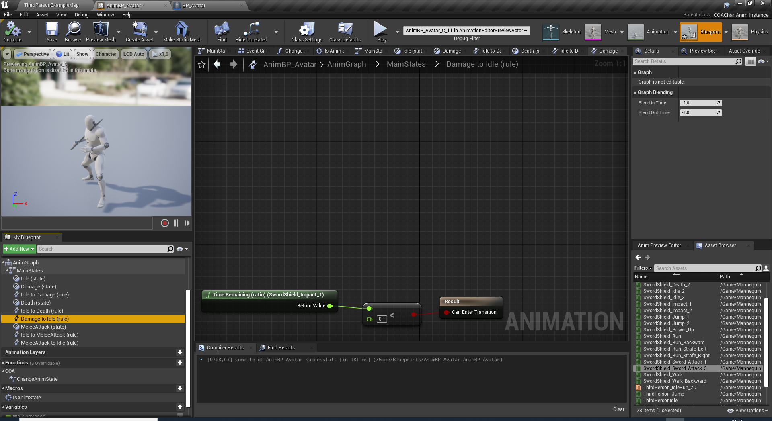
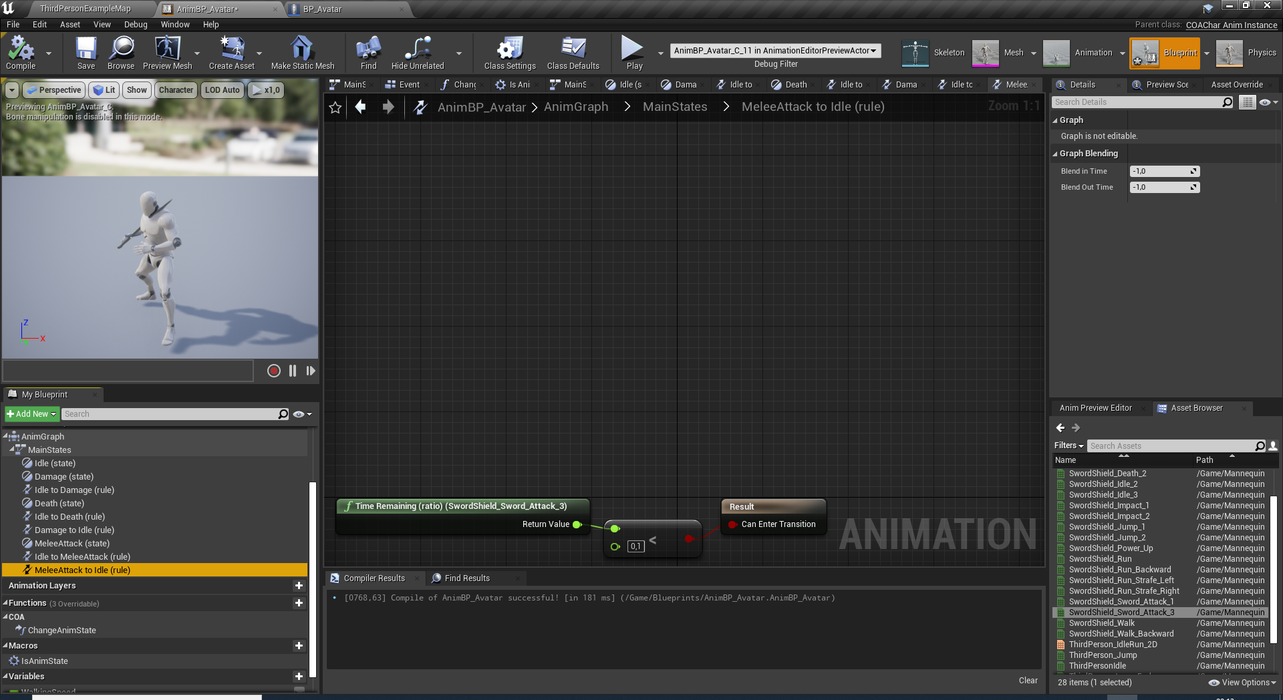
STATE OUTPUTS AND TRANSTITION RULES
Connect an animation to each states individual output animation pose.
Also add the macro to check state changes for: Idle => Damage, Idle => Death, Idle => Attack.
Transtitions from Damage => Idle, Attack => Idle are done with each animation’s remaining ratio nodes.
For animations state properly switch back to idle, we need to add a callback event for idle state.

Slide 26
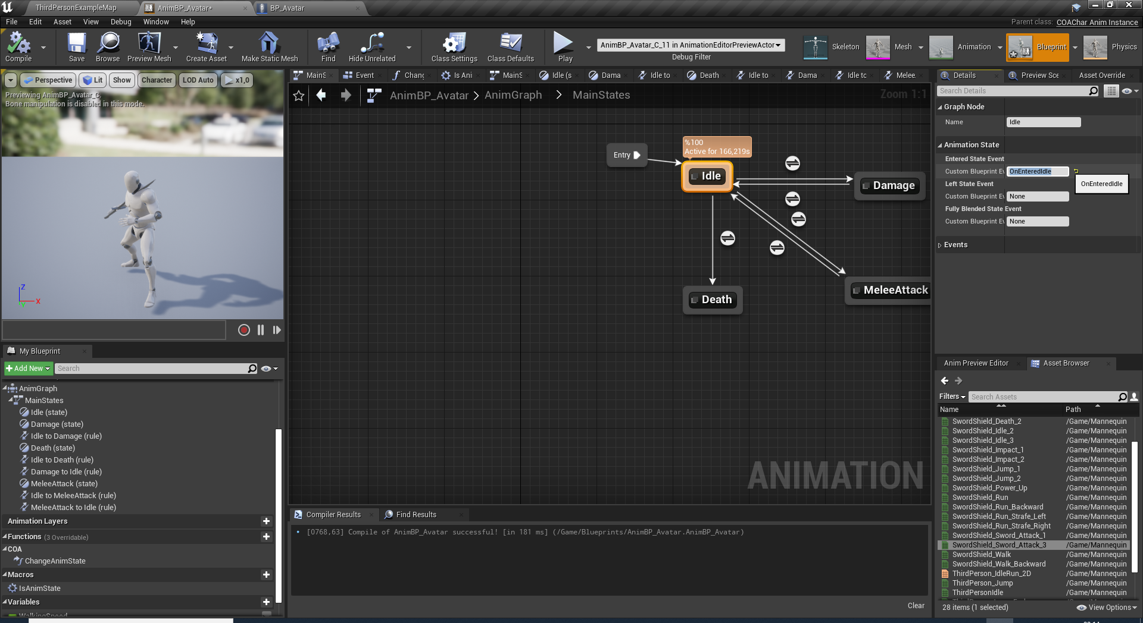
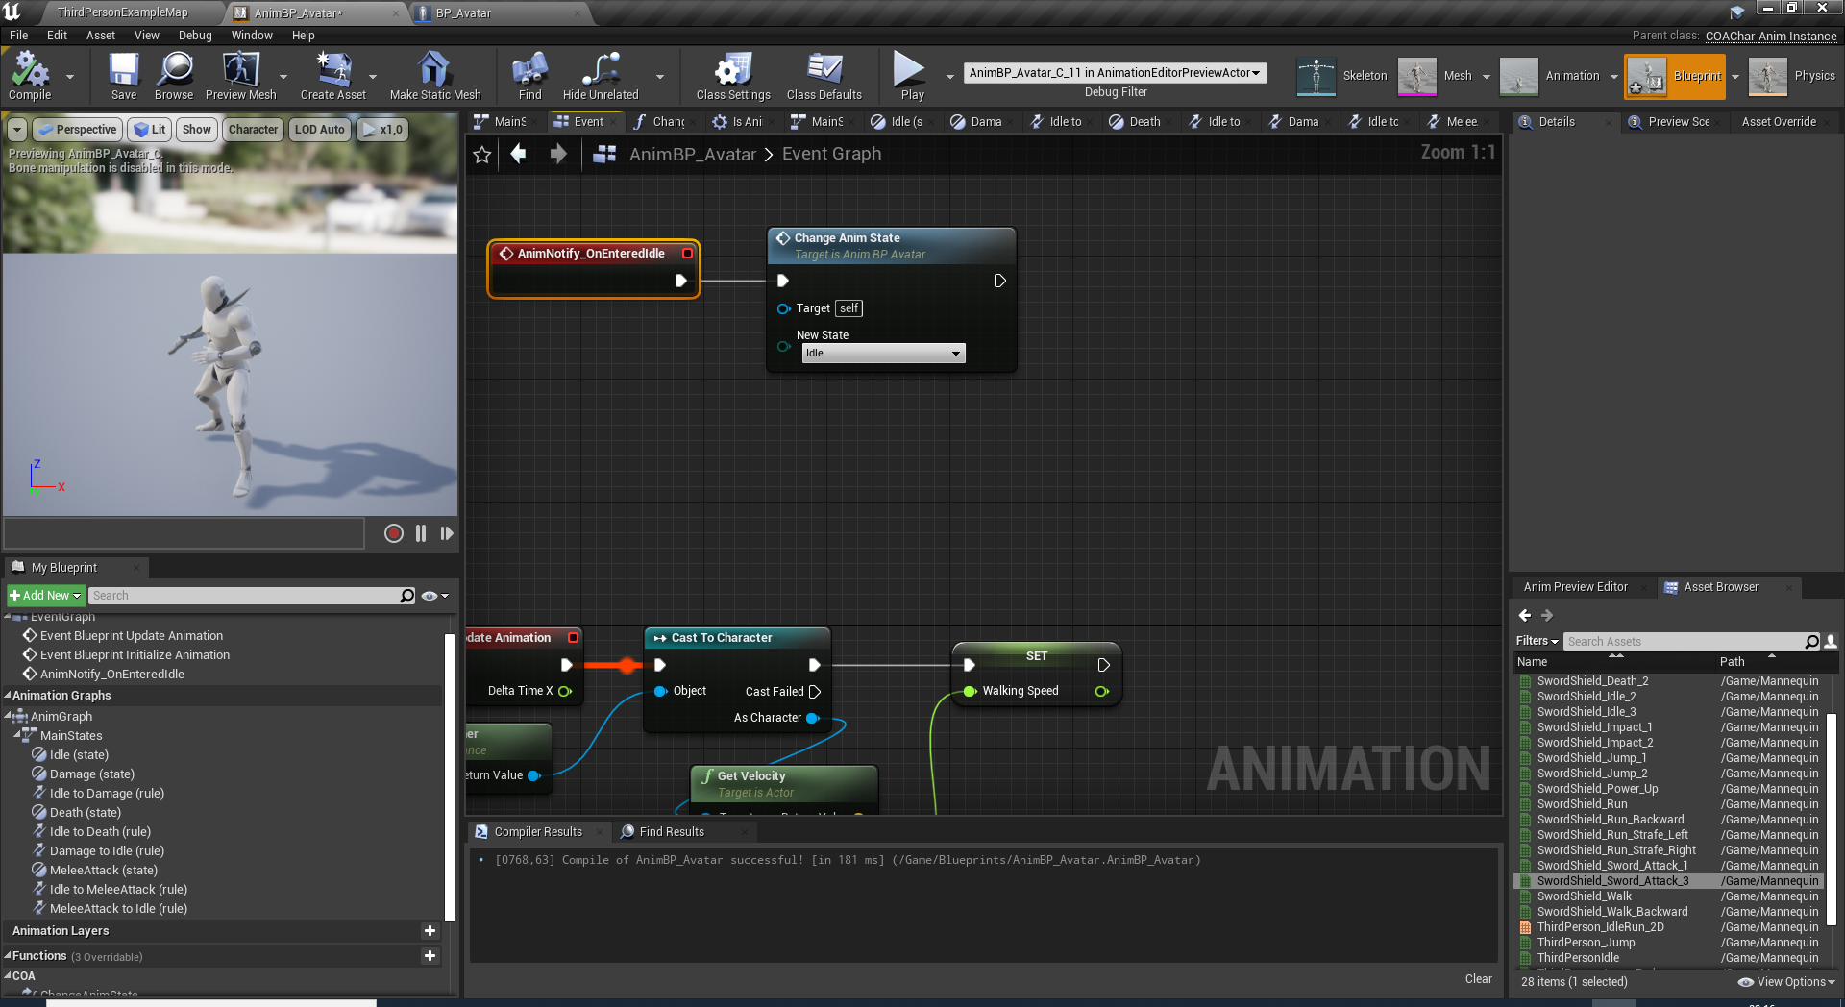
ANIMATION NOTIFY EVENTS
Select «Idle» state and enter «OnEnteredIdle» to Entered State Event.
Compile the anim blueprint.
Now AnimNotify_OnEnteredIdle event will be implementable under EventGraph.
Call ChangeAnimState to set it back to «idle» state.

Slide 27
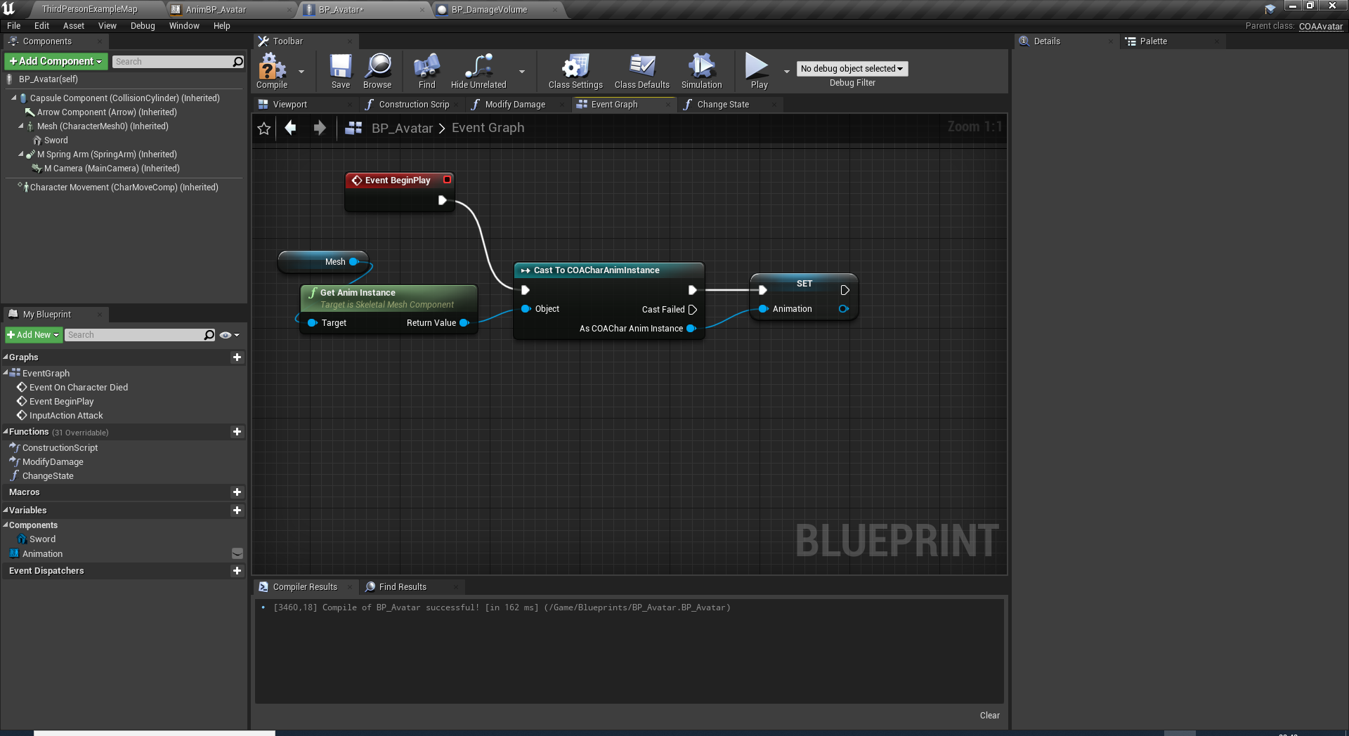
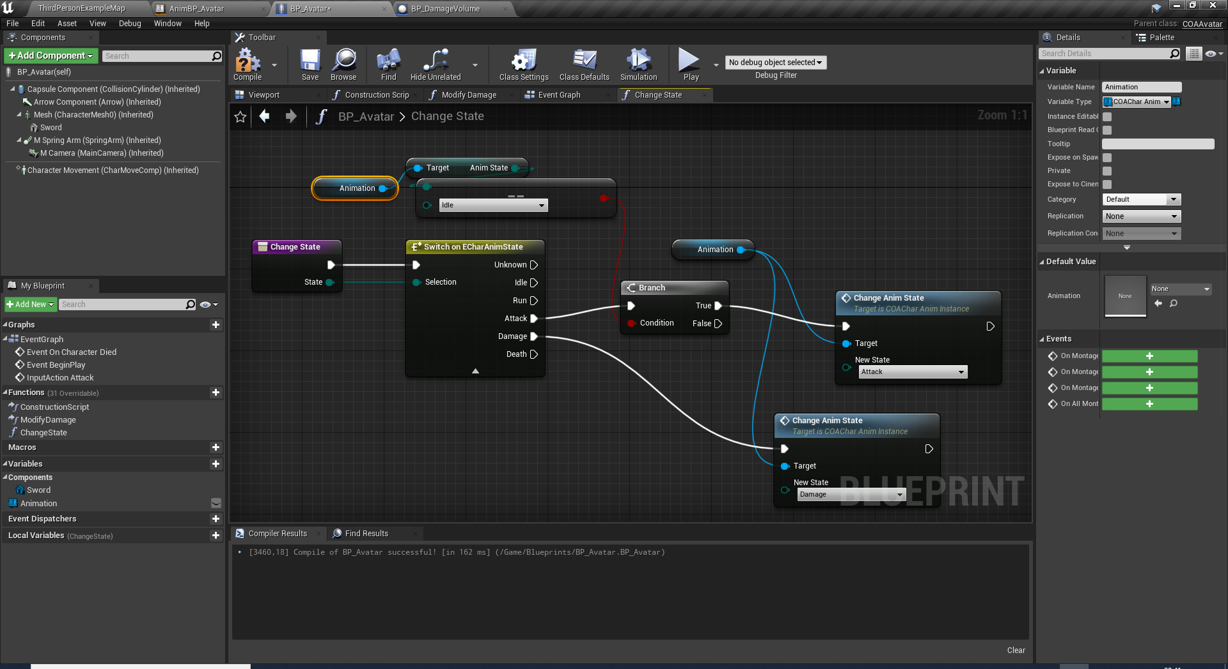
FIRING ATTACK
Add new action binding project named as «Attack»
We will need a reference for the animation instance inside BP_Avatar.
Add a new function to BP_Avatar to change the state of the character.
This «ChangeState» function selectively change the current state. For instance, we only want to switch to attack state from idle state. However, damage state may interrupt any state and start.

Slide 28
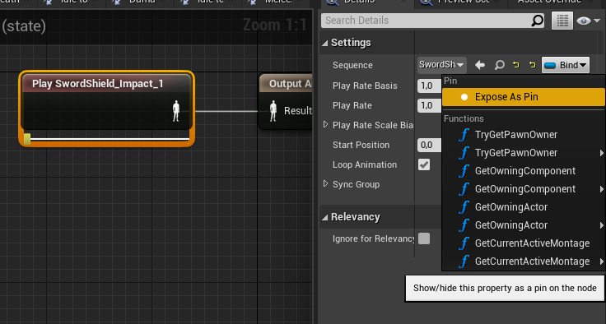
HINTS:
Decide the random damage and death animation in ChangeAnimState event.
Each animation player has its sequence property exposable as a pin. This provides to promote the pin to a variable and select a different animation everytime.
Consider addings a global scale property for ACOAAvatar::MoveForward() and ACOAAvatar::MoveRight() functions.
Consider modifying
GetCharacterMovement()->bOrientRotationToMovement property;
LABWORK:
IMPLEMENT ANIMATIONS
Implement Damage (impact) animation using BP_DamageVolume.
Implement Death animation using BP_DamageVolume.
Make the character do a different damage (impact) animation every time.
Make the character do a different death animation every time.
Make the character not move while attacking.
Make the character unable to turn while attacking.

Slide 29
Conclusion
Questions?

